Slide 1
Software Architecture
Design Principles – DIP and ISP

Slide 2
Design Principles: DIP and ISP
DIP --The Dependency- Inversion Principle
ISP --The Interface-Segregation
Principle

Slide 3
DIP - The Dependency- Inversion Principle
Structured Analysis and Design tend to create software structures in which high- level modules depend on low-level modules, and in which policy depends on detail.
It is the high-level modules that contain the important policy decisions and business models of an application.

Slide 4
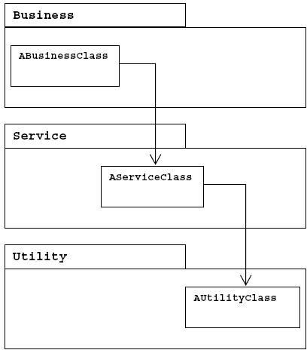
DIP – Violating DIP
If the business depends on concrete services in the service layer and the services depends on concrete utilities in the utility layer, the business depends transitively on the utilities.
This is very unfortunate because changes in low level modules have effect on high-level modules.
High-level modules will be difficult to reuse in other contexts

Slide 5
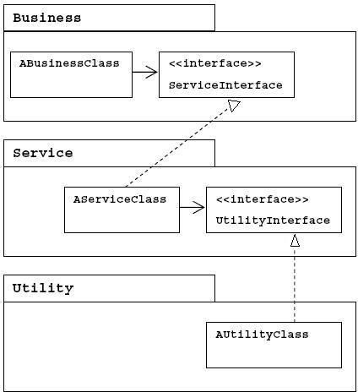
DIP – Conforming to DIP
You should invert the dependencies by using interfaces declared in the upper layer (the client “owns” the interface).
Now, the business no longer depends on a concrete service and can be reused with different implementations of the service.
NOTE: The book uses a different naming convention for the interfaces.

Slide 6
Example
// Dependency Inversion Principle - Bad example class Worker {
public void work() { // ....working }
}
class Manager { Worker m_worker;
public void setWorker(Worker w) { m_worker=w; } public void manage() { m_worker.work(); }
}
class SuperWorker {
public void work() { //.... working much more }
}

Slide 7
Example
// Dependency Inversion Principle - Good example interface IWorker { public void work(); }
class Worker implements IWorker{
public void work() { // ....working }
}
class SuperWorker implements IWorker{
public void work() { //.... working much more
}
}
class Manager { IWorker m_worker;
public void setWorker(IWorker w) { m_worker=w; } public void manage() { m_worker.work(); }
}

Slide 8
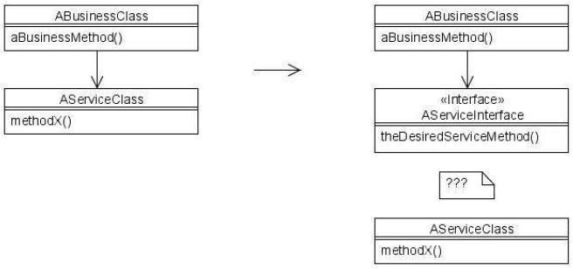
DIP – Adapting to existing
classes
The problem: what if AServiceClass already exists and
do not conform to the desired ServiceInterface?

Slide 9
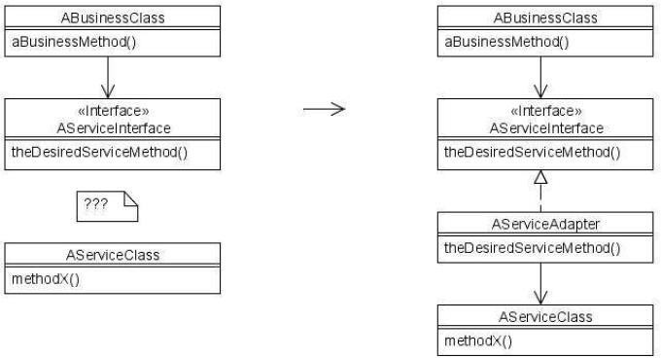
DIP – Adapting to existing classes
The solution (the Adapter Pattern):

Slide 10
DIP – Depend on abstractions
A “naive”, but useful interpretation of DIP:
No variable should hold a reference to a concrete class
No class should derive from a concrete class
No method should override an implemented method of any of its base classes

Slide 11
DIP - Summary
Traditionally:
High-level depends on low-level
Layers not separated by interfaces
Changes in low-level may affect high-level
Low-level owns the interface – high level adapts
”Procedural Design”
DIP:
Both low-level and high-level depend on abstractions
Changes in low-level usually don’t affect high-level
High-level owns the interface – low-level adapts
”Object Oriented Design”

Slide 12
Exercise
Please give an example that violates DIP and explain why? How to modify it to comply with DIP?

Slide 13
Example IV
// interface segregation principle - bad example interface IWorker {
public void work(); public void eat();
}
class Worker implements IWorker{ public void work() { // ....working } public void eat() {
// ...... eating in launch break
}
}

Slide 14
Example IV
class SuperWorker implements IWorker{
public void work() { //.... working much more } public void eat() { //.... eating in launch break }
}
class Manager { IWorker worker;
public void setWorker(IWorker w) { worker=w; } public void manage() { worker.work(); }
}

Slide 15
Example IV
// interface segregation principle - good example interface IWorker extends Feedable, Workable { }
interface IWorkable { public void work(); } interface IFeedable{ public void eat(); } class Worker implements IWorkable, IFeedable{
public void work() { // ....working }
public void eat() { //.... eating in launch break }
}

Slide 16
Example IV
class Robot implements IWorkable{
public void work() { // ....working }
}
class SuperWorker implements IWorkable, IFeedable{ public void work() { //.... working much more }
public void eat() { //.... eating in launch break }
}
class Manager { Workable worker;
public void setWorker(Workable w) { worker=w; } public void manage() { worker.work(); }
}

Slide 17
Conclusion
Fat classes cause coupling between their
clients.
When one client forces a change on the fat class, all the other clients are affected.
The interface of the fat class should be broken into many client-specific interfaces.
This breaks the dependence of the clients on methods that they don’t invoke, and it allows the clients to be independent of each other.

Slide 18
Exercise
Please give an example that violates ISP and explain why? How to modify it to comply with ISP?

